Slide 1

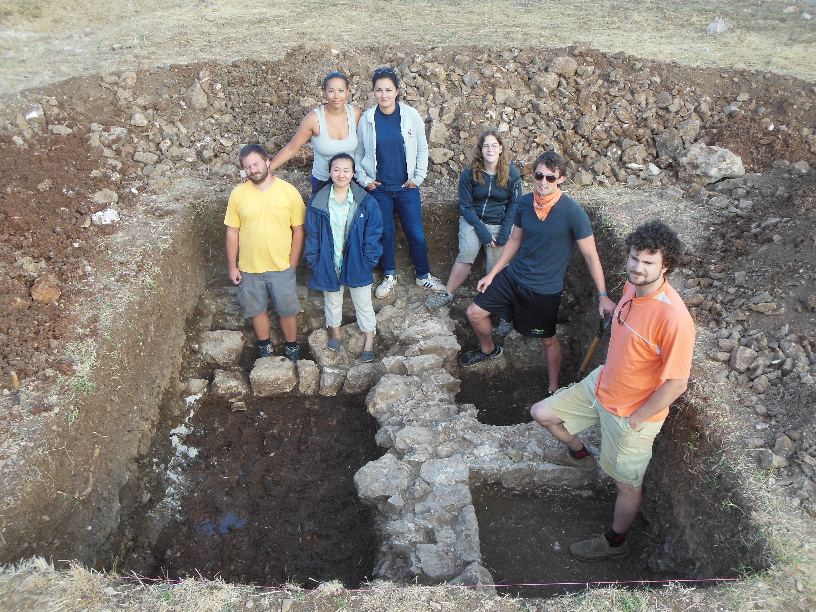
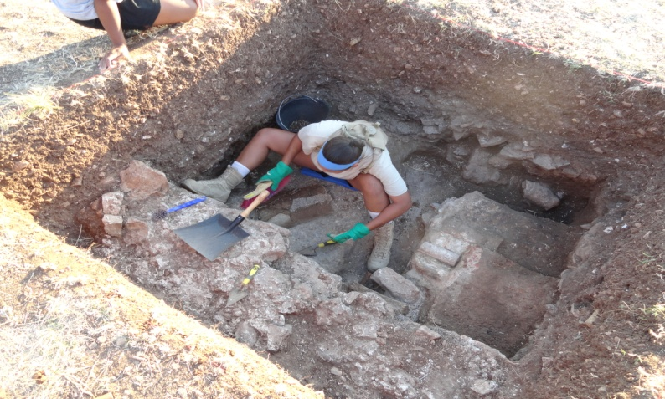
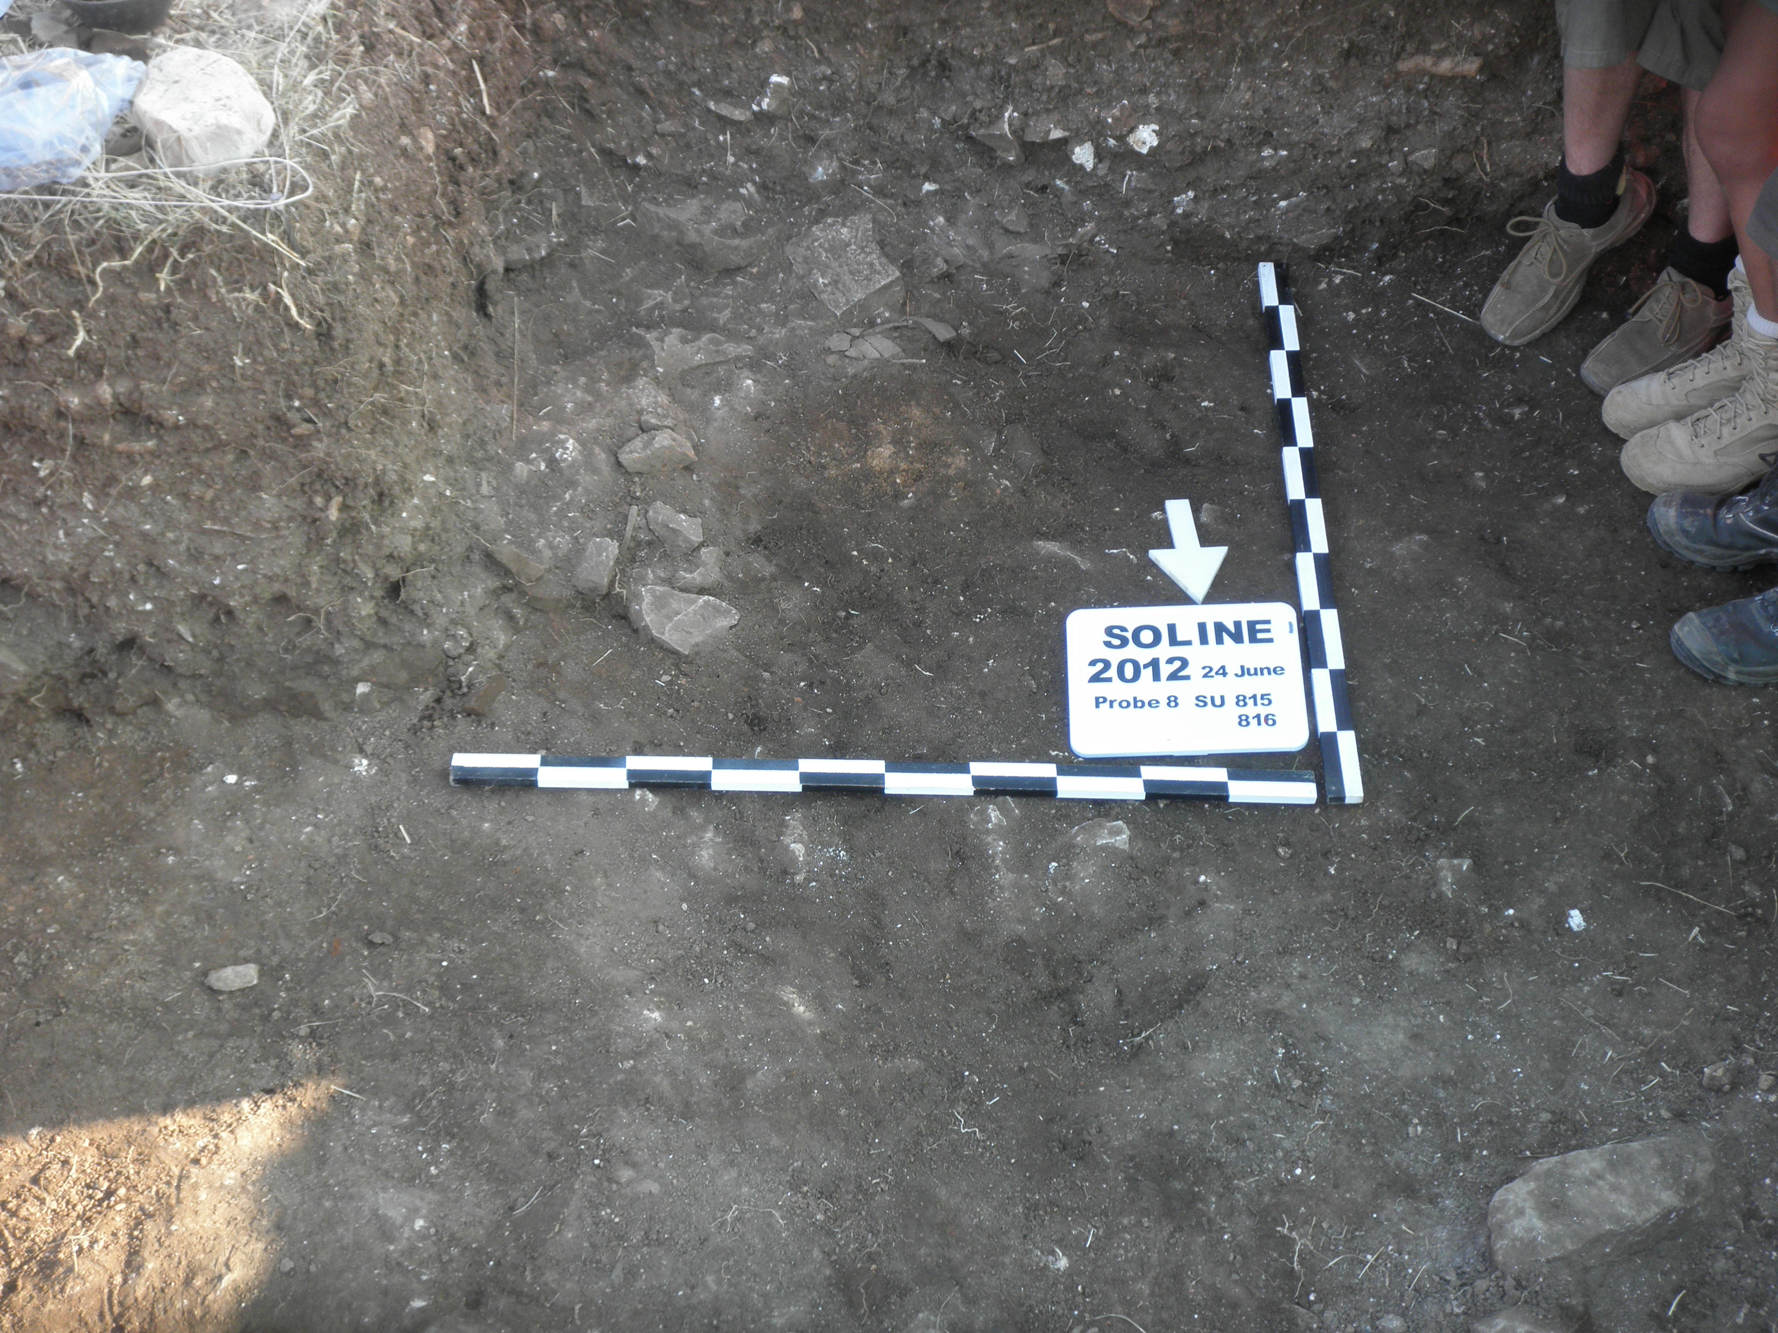
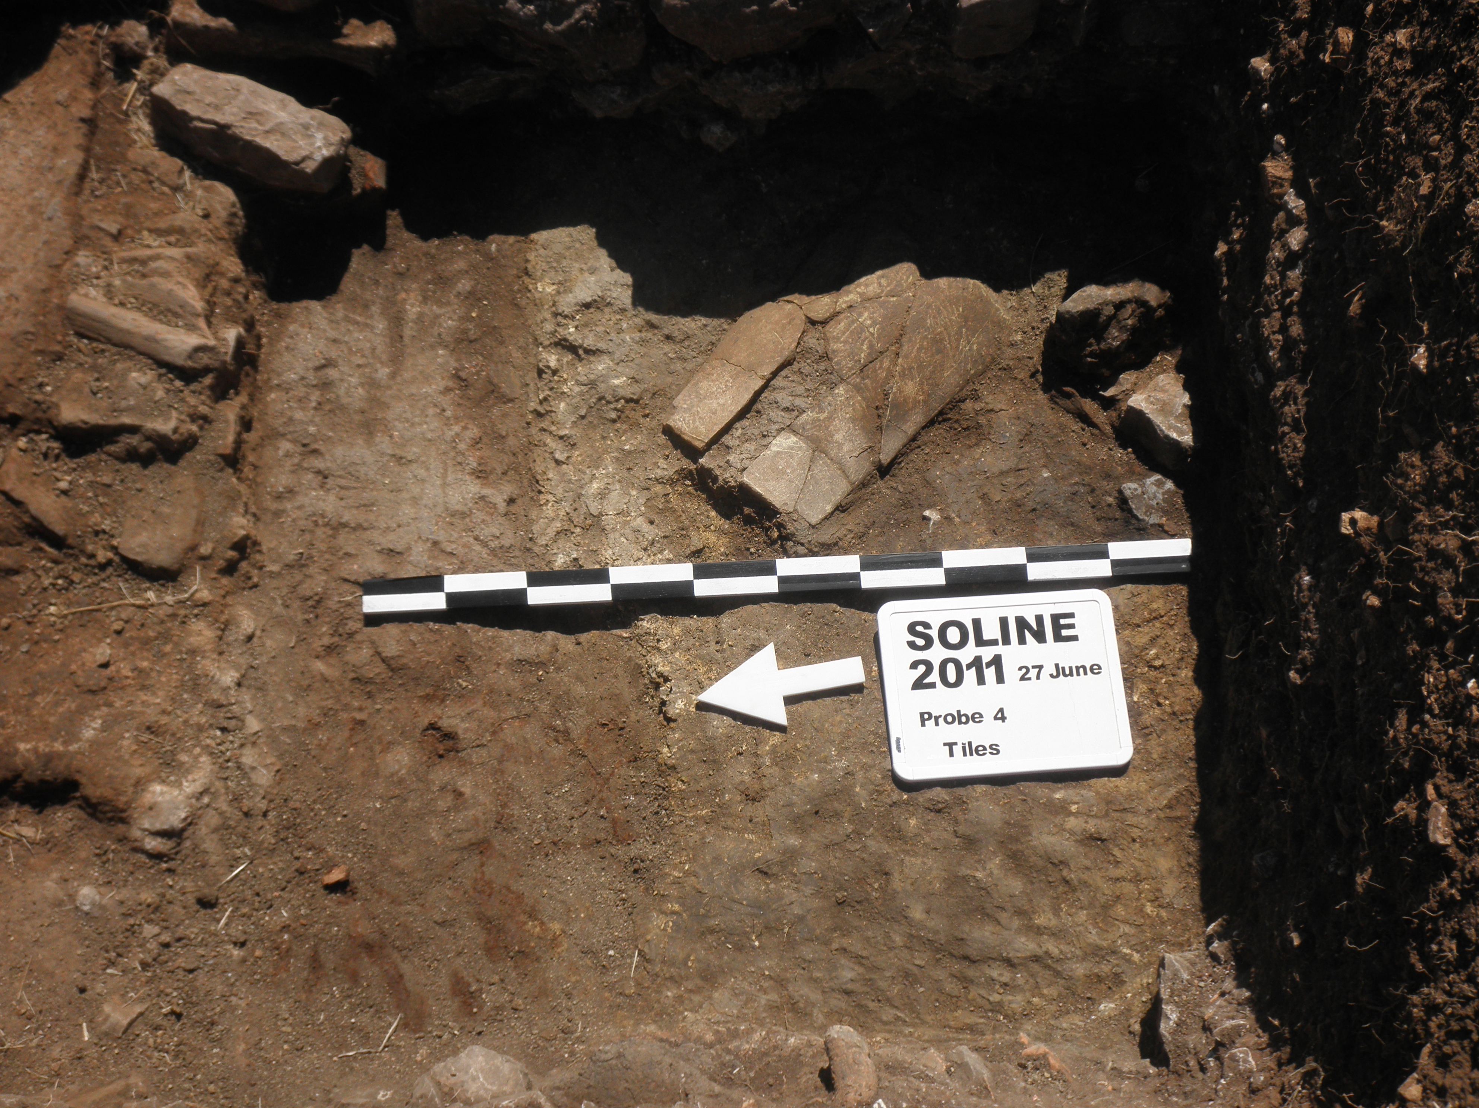
INFANT BURIALS IN ROMAN VILLAS
Laura Thompson-Woodland
University of St. Thomas
This research was made possible in part by the Grants and Research Office
Possible infant burial under a broken amphora or pithos (a large storage jar). There were several small stones placed in a formation along one side of the infant burial. ( Below)
Burials of children and adults within Roman villas are not uncommon and generally date after the villas were abandoned.
Trench 11 in 2013
In 2011 I found some skeletal fragments under roof tiles within a room in Trench 4. (Above)

